Slide 1








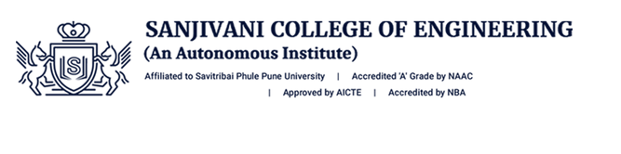

Technovation 2023
VM Institute of Engineering
and Technology, Nagpur
Information Technology Department
Award Sponsor
Merch Sponsor

Slide 2
A PRESENTATION ON
“ ONLINE BUS PASS SYSTEM ”
By
SHRUTI KOTHEKAR
DEEPAK VERMA
PRAGATI GEDAM
ROHIT GHAWAT
Under the guidance of
ASST. PROF. TARUN YENGANTIWAR

Slide 3
Contents
Introduction
Literature Survey
Problem Statement
Proposed System
System Description
Results and Discussion Project
References

Slide 4
Introduction
This project is created to provide “safe, reliable, saving, efficient and affordable” services for user. This idea would help the user in a better way.
As per the previous system the user had to do each and every process manually, but this system helps user to make the work bit faster through online application and transection .
The user can take print out of this bus pass from Pass id Number within a day and use them.

Slide 5
Literature Survey
Sadaf Sheikh, Gayatri Shinde, Mayuri Potghan, Tazeen Sheikh “application which will be used for the process of booking a ticket for travel through local trains or metros”.
Ramadevi. K, Murugan. S, Bharath. S “mobile ticket application developed for android in which user procure ticket in future” .
Neha sandikar, rane dipti, sachin panday proposed the various techniques for buying metro tickets or local railway tickets through their Smartphone application and introduced ticket checker .

Slide 6
Problem Statement
The person has to visit the counter and have to submit the details and then they have to wait for approval. For each and every process there is time limit specified if the person fails to go on time then all the transactions will be cancelled.
In this existing system was used to bus details maintain through file. And after bus information are stored to computerize .
Which is much of time consuming process and more importantly it is error prone. At present system bus pass collect from depot very rare one. User can facing lot of problems.
At present keeping records is manual.

Slide 7
Proposed System
In the proposed system user register their details through online and get their unique Pass id Number for further processing. In this bus pass, all the required details such as candidate name, address, identity proof, mail id, name of the school (government/private), validity period, amount paid (free for government school students) and photo copy of the candidate are provided.
Features of the Proposed System
To provide huge maintenance of records .
Flexibility of Online transactions can be completed in time .
Easily bus pass apply online and take print of pass within a day.

Slide 8
System Description
Software Requirements
Language : PHP, MySQL Database
Front End Tool: PHP, HTML, CSS, JS, BOOTSTRAP
Operating System: Windows 7.
Hardware Requirement
Processor: Intel Pentium IV Processor
Random Memory: 4 GB
Hard Disk : 500 GB
Mouse
Keyboard

Slide 9
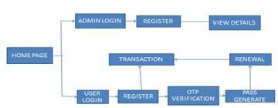
System Description
CONCEPTUAL DRAWINGS /FLOW CHART

Slide 10
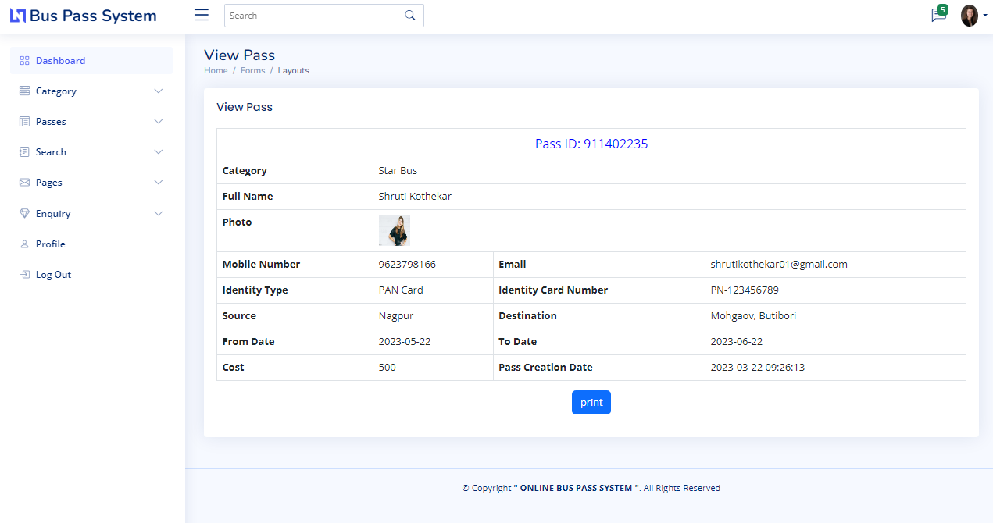
Project Picture :
SAMPLE FIGURE
Figure. Pass

Slide 11
Results and Discussion
This system can be used in any bus transport undertaking services.
Using the system in government and private sectors can exclude the use of human efforts and saves lot of money and time.
This online bus pass software system will help students and passengers get bus passes online and eliminate the need of standing in queues for passes or collecting a ticket for each journey.

Slide 12
References
[1] Swathi Shastry1, Farzana Nadaf2, Sourabh Kulkarni3, "Assessment Performance Analyzer", International Journal of Latest Engineering and Management Research (IJLEMR) ISSN: 2455-4847, www.ijlemr.com || Volume 02 - Issue 02 || February 2017 || PP. 61-72.
[2] Raghavendra V, M S Sowmya, Gokul G, Mohammed Inzamamul Mistery, Sahil Jakhar, "Design and Implementation of a System for University Automation Assessment", International Journal of Innovative Research in Computer and Communication Engineering, Vol. 5, Issue 5, May 2017.
[3] Ashwin Mehta1, Jugal Patel2, Aditya Mewada3 , "STUDENT RESULT ANALYSIS SYSTEM", International Research Journal of Engineering and Technology (IRJET) e-ISSN: 2395-0056, Volume: 05 Issue: 04 | Apr-2018.
[4] www.Wikipedia.org .

Slide 13
THANK YOU

